Slide 1
Simple Linear Regression

Slide 2
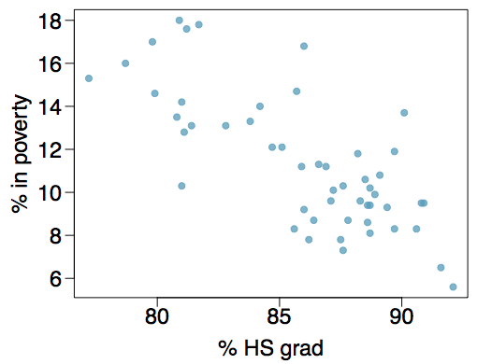
Poverty vs. HS graduate rate
The scatterplot below shows the relationship between HS graduate rate in all 50 US states and DC and the percent of residents who live below the poverty line (income below $23,050 for a family of 4 in 2012).

Slide 3
Poverty vs. HS graduate rate
The scatterplot below shows the relationship between HS graduate rate in all 50 US states and DC and the percent of residents who live below the poverty line (income below $23,050 for a family of 4 in 2012).
Response variable:
% in poverty
Explanatory variable:
% HS grad

Slide 4
Poverty vs. HS graduate rate
The scatterplot below shows the relationship between HS graduate rate in all 50 US states and DC and the percent of residents who live below the poverty line (income below $23,050 for a family of 4 in 2012).
Response variable?
% in poverty
Explanatory variable?
% HS grad
Relationship?

Slide 5
Poverty vs. HS graduate rate
The scatterplot below shows the relationship between HS graduate rate in all 50 US states and DC and the percent of residents who live below the poverty line (income below $23,050 for a family of 4 in 2012).
Response variable?
% in poverty
Explanatory variable?
% HS grad
Relationship?
linear, negative, moderately strong

Slide 6
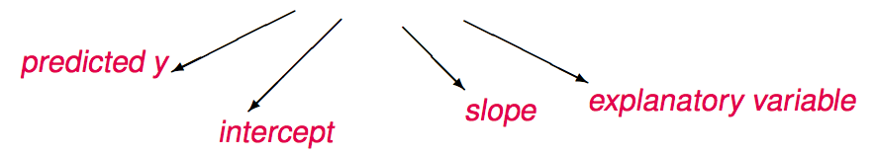

The linear regression line
$$y=β_{0}+β_{1}x+ε$$

Slide 7
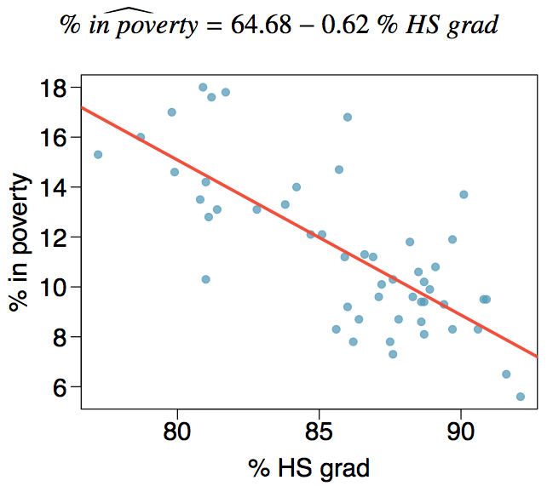

The linear regression line
$$\hat{y}=b_{0}+b_{1}x$$

Slide 8
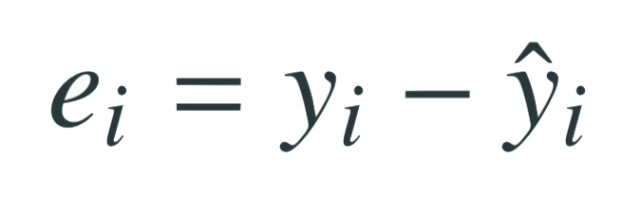
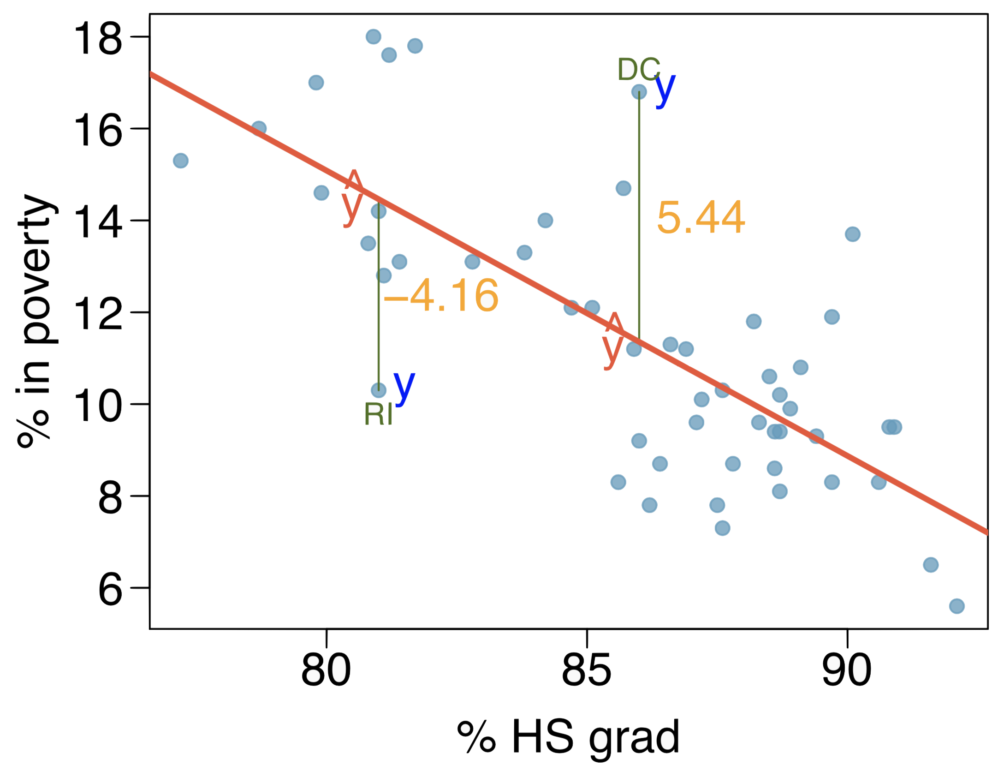
Residuals
Residual is the difference between the observed (y_{i}) and predicted ŷ_{i}.
% living in poverty in DC is 5.44% more than predicted.
% living in poverty in RI is 4.16% less than predicted.

Slide 9
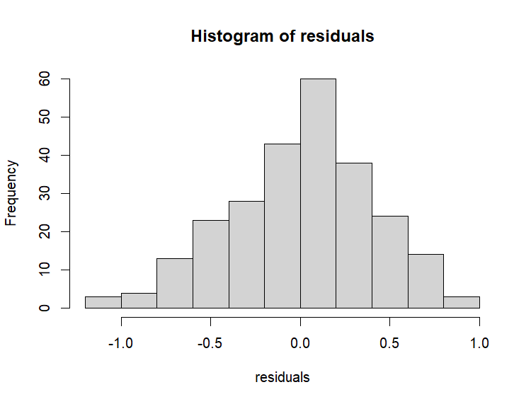
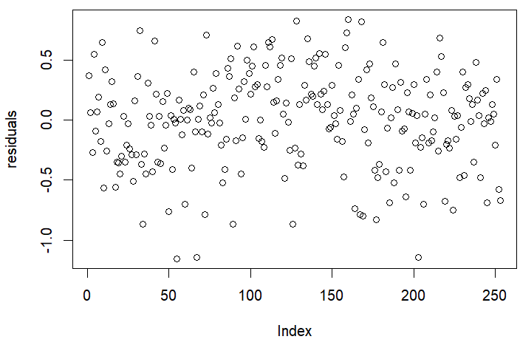
Conditions
Linearity
Scatterplot
Nearly normal residuals
Histogram of residuals
Constant variability
Plot of residuals

Slide 10
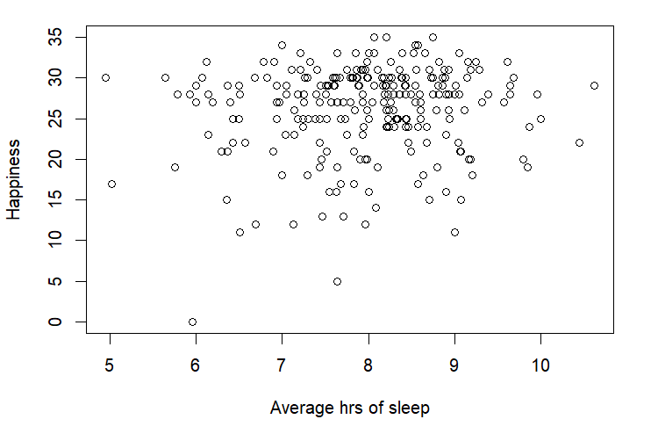
Sleep Study

Slide 11
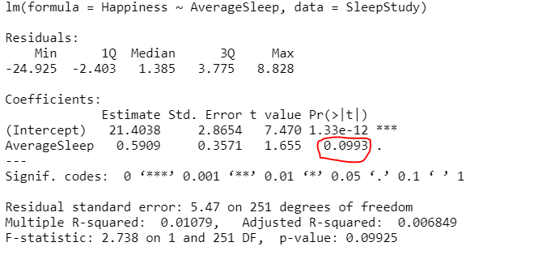
Testing for the slope
We always use a t-test in inference for regression.

